Slide 1
Door Locking System
By -
Yash Kamate
Kaustubh Karlekar
Aditya Ketkar
Guide -
Prof. R S Talware

Slide 2
Introduction
Many times we forget to carry the key of our home.
Or sometimes we come out of our home and door latch closes by mistake.
In these cases it is really difficult to get inside the house.
This project is designed to solve this purpose.

Slide 3
Highlights
Door-latch opening using a password entered through keypad.
Buzzer alarm when password is entered wrong for multiple times.
User can change this password anytime he/she wishes using a keypad.
Does not focus on Automation of door operation; rather provides a sophisticated way of securing a particular area.

Slide 4
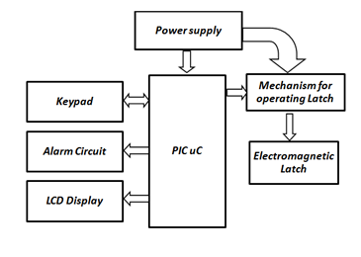
Block Diagram

Slide 5
Operation
Use of 8-bit microcontroller PIC18F4520.
The password is entered through the keypad.
The password is matched with the stored password in the internal memory of microcontroller.
If found correct, the solenoid latch is actuated through a signal from microcontroller using relay mechanism.(Door opens)

Slide 6
Contd…
If the password doesn’t match, the door remains closed.
Maximum of 3 chances are given to enter the password, failing to which the buzzer alarm is sounded.
Facility to reset/change password is also provided.

Slide 7
Circuit Diagram

Slide 8
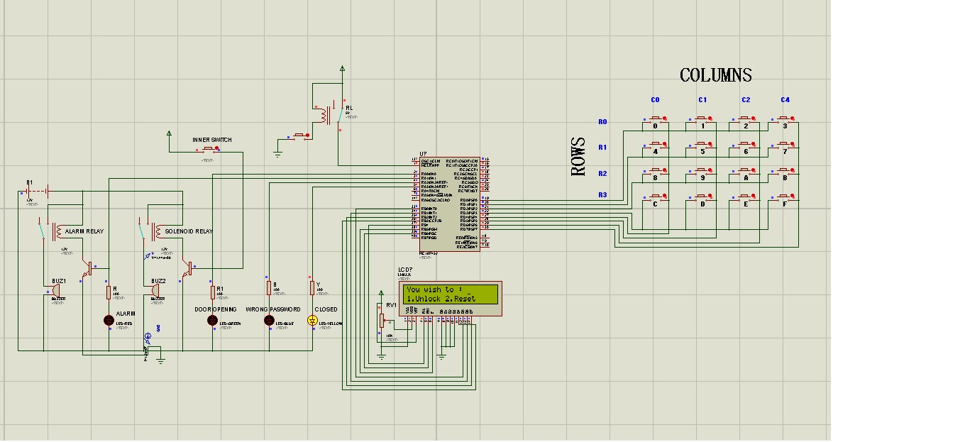
Simulation

Slide 9
Conclusions
The system provides comparatively low cost security solution.
The system consumes less power and is highly customizable.
Uses commonly available components. Hence repair and maintenance is easy.
The level of security provided through this system is high.

Slide 10
Refererences
1. http://www.electronicshub.org/password-based-door-lock-system
2. http://www.projectsof8051.com/password-based-door-locking-system

Slide 11
Thanking You…

